Slide 1

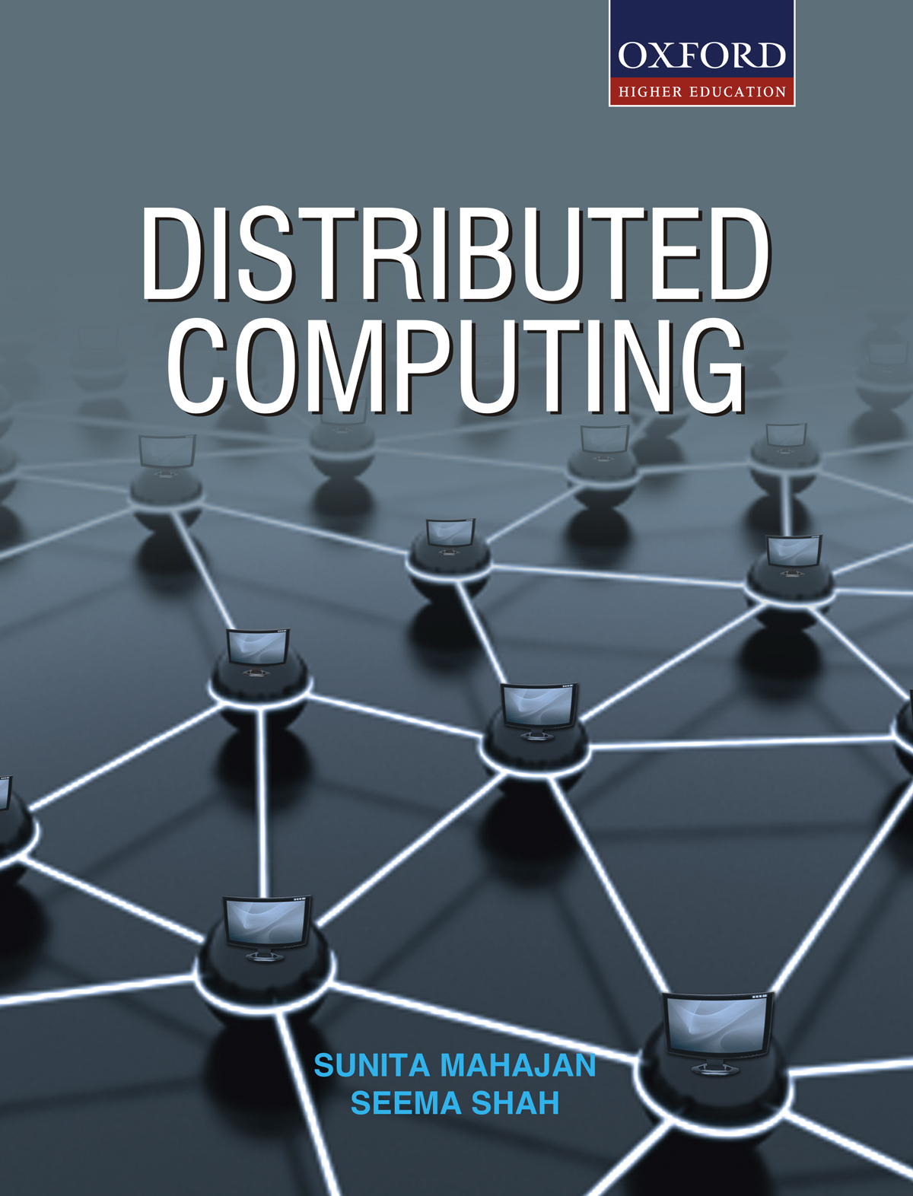
DISTRIBUTED COMPUTING
Sunita Mahajan, Principal, Institute of Computer Science, MET League of Colleges, Mumbai
Seema Shah, Principal, Vidyalankar Institute of Technology, Mumbai University

Slide 2
Chapter - 8
Distributed File System

Slide 3
Topics
Introduction to DFS
File models
Distributed file system design
Semantics of file sharing
DFS implementation
File caching in DFS
Replication in DFS
Case study

Slide 4
Introduction To DFS

Slide 5
Functions of DFS
Permanent storage
Remote information sharing
User mobility
Availability
Diskless workstation

Slide 6
Components of DFS
Storage service
True file service
Name service
File service v/s file server

Slide 7
Desirable features of a good DFS
Transparency
User mobility
Performance
Simplicity
Ease of use
Scalability
Availability
Reliability
Data integrity
Security
Support for heterogeneous systems

Slide 8
File Models

Slide 9
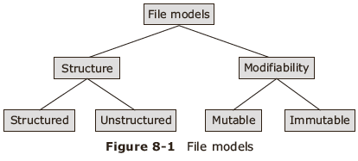
Classification of file models
Based on file structure and how they can be modified

Slide 10
Distributed File System Design

Slide 11
Components of DFS
True file service
  Operations on individual files
Directory service
  Creating and managing directories

Slide 12
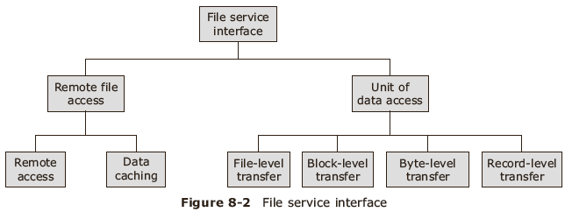
Types of File service interface

Slide 13
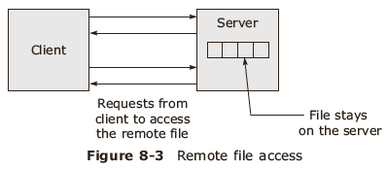
Remote access model
NFS and Locus

Slide 14
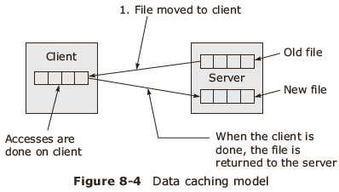
Data caching model/Upload download model

Slide 15
Unit of data access transfer
File level transfer
Block level transfer
Byte level transfer
Record level transfer

Slide 16
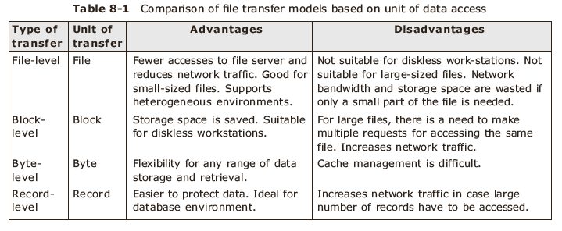
Comparison

Slide 17
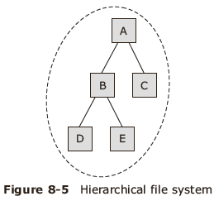
Directory server interface

Slide 18
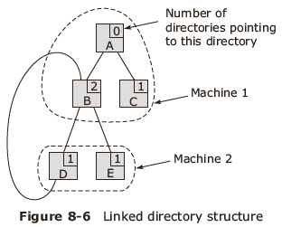
Directory structure

Slide 19
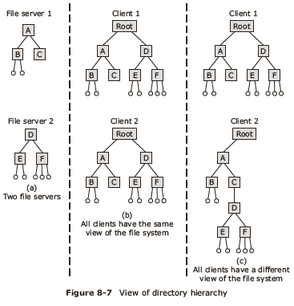
Directory view

Slide 20
Naming Transparency
/ Root
Server 1
Server 1Serve
Server 2
Server 3
Server 4
Dir 1
Dir 1
Dir 4
Dir 4
Y
Y
Fig 8.8 Naming Transparency

Slide 21
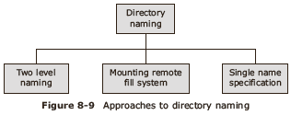
Directory naming approaches

Slide 22
Semantics Of File Sharing

Slide 23
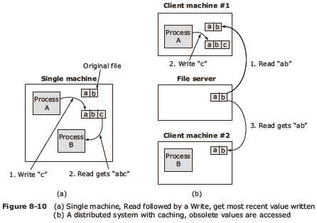
File sharing

Slide 24
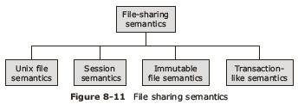
Types of file sharing semantics

Slide 25
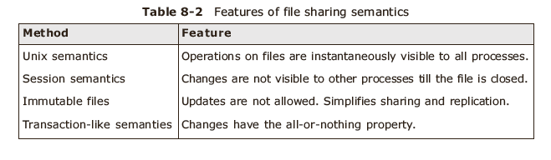
Comparison

Slide 26
DFS Implementation

Slide 27
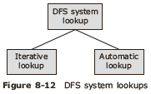
Methods of DFS lookup

Slide 28
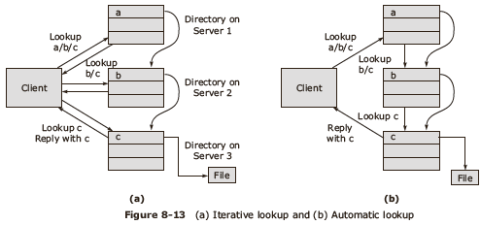
Lookup methods

Slide 29
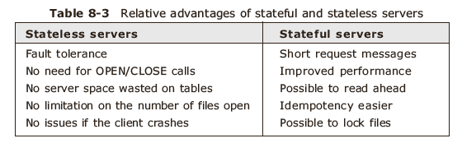
Stateful vs stateless servers

Slide 30
File Caching In DFS

Slide 31
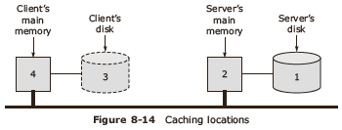
File caching locations

Slide 32
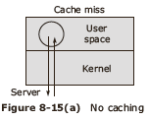
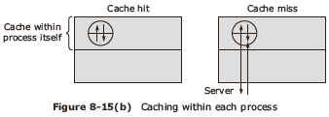
Caching techniques-1

Slide 33
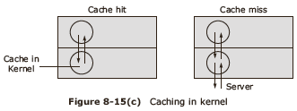
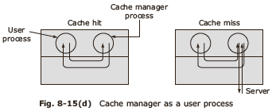
Caching techniques-2

Slide 34
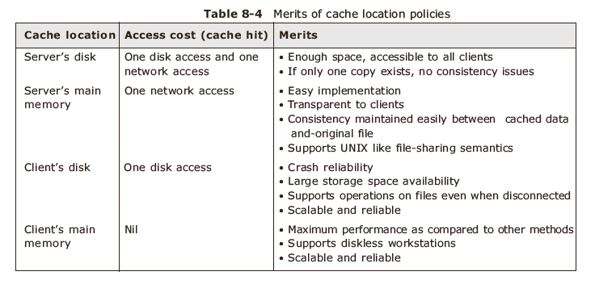
Comparison of caching policies

Slide 35
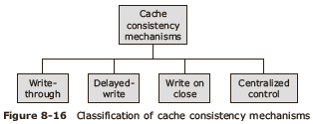
Cache consistency

Slide 36
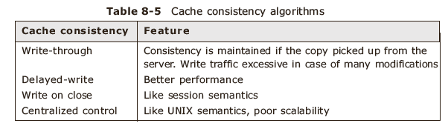
Comparison of Cache consistency algorithms

Slide 37
Replication In DFS

Slide 38
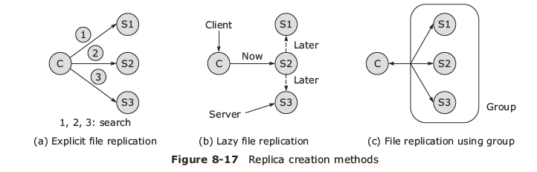
Replica creation

Slide 39
Update protocols
Primary copy algorithm
Voting algorithm

Slide 40
Case Study

Slide 41
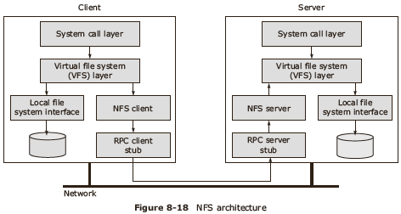
Network File System architecture

Slide 42
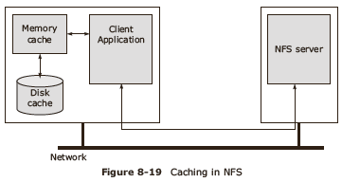
NFS: caching

Slide 43
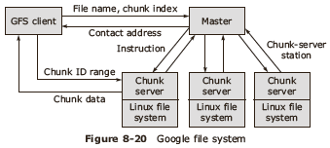
Google File system

Slide 44
Summary
Introduction to DFS
File models
Distributed file system design
Semantics of file sharing
DFS implementation
File caching in DFS
Replication in DFS
Case study

